Slide 1

Business Health Predictor
GROUP 09 | 04 AUGUST 2023
Project Team: Zach Tillery, Scott Hills, Nuri David, Al Ameen Temitope Salako, and Aleks Prela

Slide 2

BUSINESS PROBLEM
Large institutions have access to sophisticated investment tools and metrics that aid them with investing their money into different public companies.
However, individuals with less access and smaller portfolios do not have the same advantages to investment tools and quality research.
Smaller clients are trying to achieve financial success and freedom but are disadvantaged without the proper investing help the larger investment institutions have.
Notes:
Many big clients have access to different tools and metrics that help them invest their money into different public companies. However, individuals with less knowledge and smaller portfolios have no access to those tools.
We help the smaller clients by giving them a tool that not only is more accessible, but very accurate and reliable.
Our model helps bridge the gap in resources for investing between the smaller and bigger individual investors.

Slide 3

BUSINESS SOLUTION
Develop a machine learning model that predicts future performance of business health that delivers on the following objectives.
Accuracy / Investor Confidence
Accessibility / User Friendly
Straight forward Results
Notes:
We not only give smaller clients a tool that’s accessible, but also very accurate and reliable.
Accuracy and Robustness- Handles many different metrics to calculate accurate predictions on a company's health.
Risk Mitigation- Reduces risks by making informed decisions based on a company's financial health, and warns investors if company has vulnerabilities overlooked by traditional analysis.
Investor Confidence- Helps investors understand company financials better, allowing them to invest with more peace of mind knowing there's stability.
Adaptability- Adapts to changing market conditions and incorporate new data, making it a valuable tool for investors in any economic environment. Dynamic.
Down the Road- Our Business Health score helps not only understand shorter term safety but is a great predictor of long term well-being.

Slide 4








Calculating Future Business Health
modeling
Summarization of features and formulation of our model's target predictor.
SOLVENCY
EBIT / TOTAL ASSETS
LIQUIDITY
NET SALES / TOTAL ASSETS
PROFITABILITY
WORKING CAPITAL / TOTAL ASSETS
FUTURE BUSINESS HEALTH
Notes:
Tags: technology, callout, icons

Slide 5

Future Business Health Rating
Modeling
Business Health is metric that tracks a company’s financial health for the following fiscal year. This metric considers the current year’s information and aggregates financials into a score that can be used for an Investment categorization. Our model utilizes this score by taking public financial data and calculating the current business health rating. Once the current business health rating is calculated, the model will attempt to predict the company’s business health for the following year. This predictive ranking is provided to help make decisions on what companies to invest in.
Suggested Investment Category | Lower | Average | Higher
Business Health Rating
1
2
3
4
5
6
7
8
9
Notes:
Tags: table, proposal, approach, objectives

Slide 6

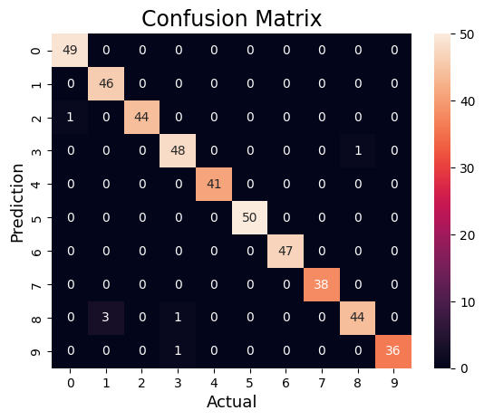
Model performance
Defining Model Performance
Traditionally this model’s performance would be defined by how accurate the model is. This is done by seeing how many values the model correctly predicted.
Since our model is working with future financial predications, perfect categorization can be extremely difficult. To combat this, we decided to include instances where the model predicted the value within 1 unit of the true value as being accurate.
Notes:
We define the performance of our model based on its accuracy in predicting the actual values of business health. The matrix along the diagonals tells us the # of times a prediction was the same as the actual value. Our model takes into consideration numerous factors which makes it difficult for the model always to being on point. So, we decided to have an adjusted accuracy which which encaptures +/- deviation from the actual business health

Slide 7
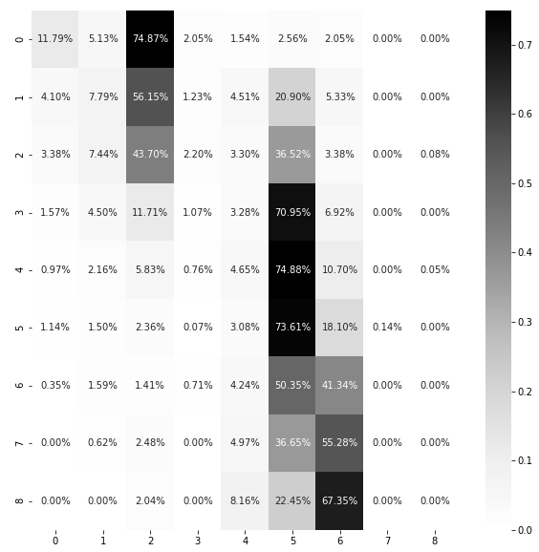
LinearSVC Model
Baseline Model Analysis
Overall Accuracy
Adjusted Accuracy
27.3%
63.5%

Slide 8
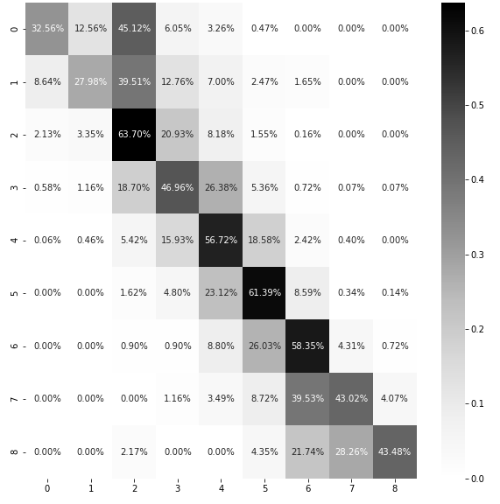
Selected Model
Selected Model Analysis
Overall Accuracy
Adjusted Accuracy
54.9%
88.9%

Slide 9

Next Steps / Future Opportunities
Continuously refreshing of the dataset to obtain the latest financial information for further training and testing of the model.
Review for changes in predictive modeling around impactful business events (Ex. pre- and post-Covid, recessionary periods, etc.)
Include industry categorizations for each companies and review how the models are affected when classified by industry.
Include the outstanding stock share count and price of stock at year-end to review any effects on the model as built.

Slide 10
Questions?
THANK YOU!

